Slide 1
LINK
GROUP
LINK
Automation Engineering (Shanghai) Co.,Ltd.
GROUP
霖和自动化工程(上海)有限公司
Training Record
Pham Tung Lam : PLC Engineer
Module Sequence

Slide 2
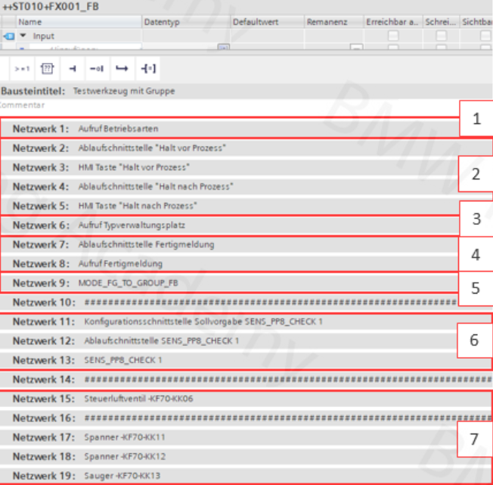
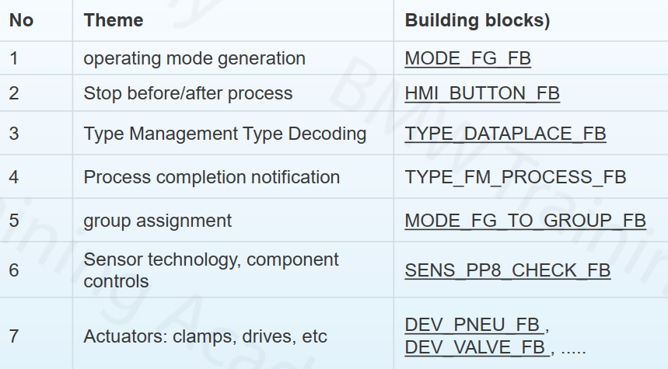
SOFTWARE / NETWORK STRUCTURE WITHIN A COMPONENT WITH A SEQUENCER
All relevant blocks that are directly involved in the sequential program are called within a component This results in the following typical block structure:

Slide 3
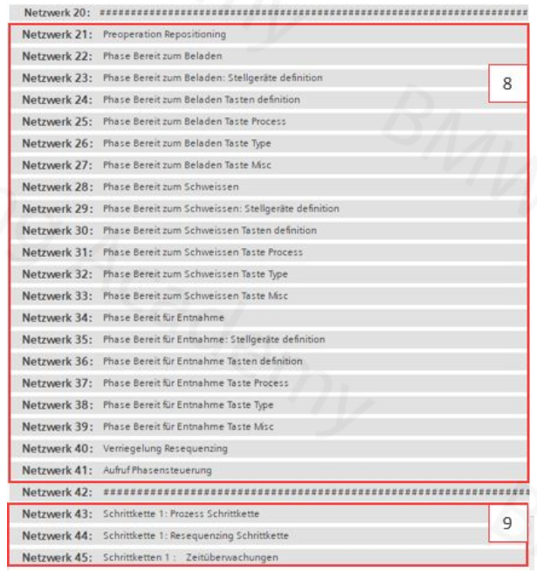
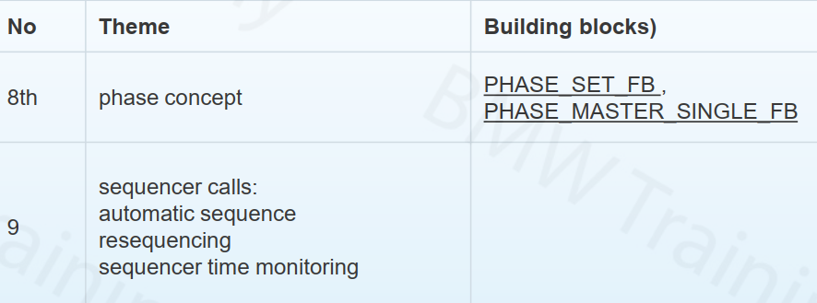

Slide 4
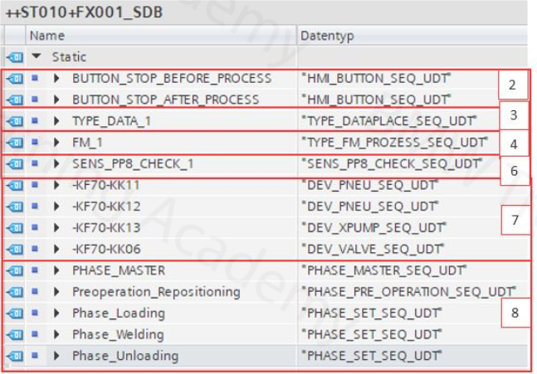
PROCESS -RELEVANT SIGNALS : SDB
All process-relevant blocks have a "SEQ" interface , which is based on a block-specific UDT definition. The corresponding variables for this are created in
With this, sequence-relevant signals can also be controlled / queried across blocks, for example the control of an actuator from the sequencer! The use of markers is therefore not necessary and also not permitted!

Slide 5
SEQUENCERS PHASE STRUCTURE

Slide 6
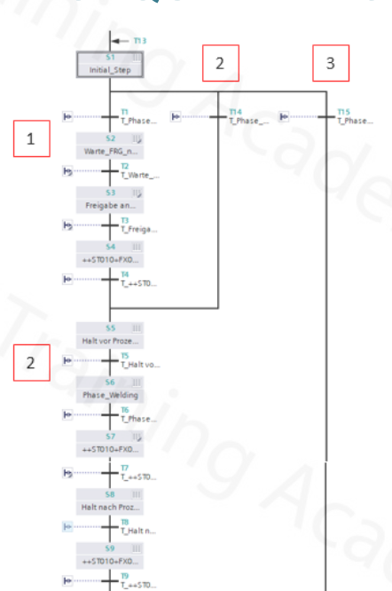
The production process is structured in phases. The individual phases are therefore synchronization points at which it must be possible to restart the system. Fulfilled phases are therefore sequencer basic positions and have a direct effect on the overall basic position of a FG!

Slide 7
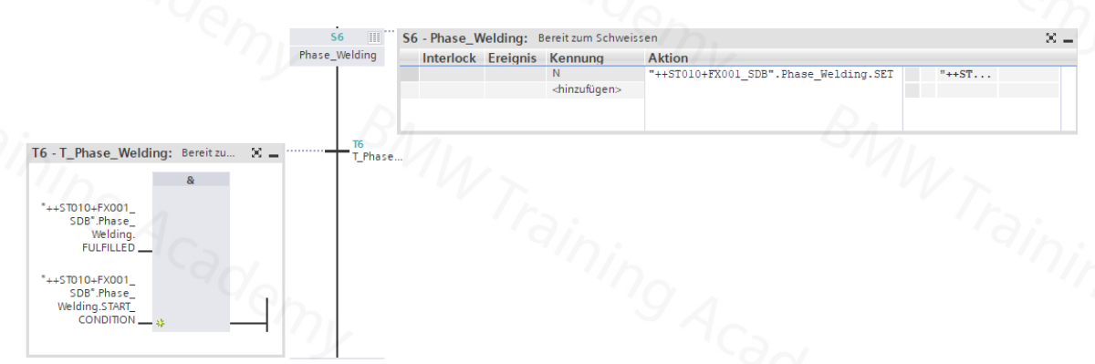
ACTIVATE PHASE In the process, exactly one phase must always be active. This is done using the following logic, which is also formed exclusively from standardized signals:

Slide 8
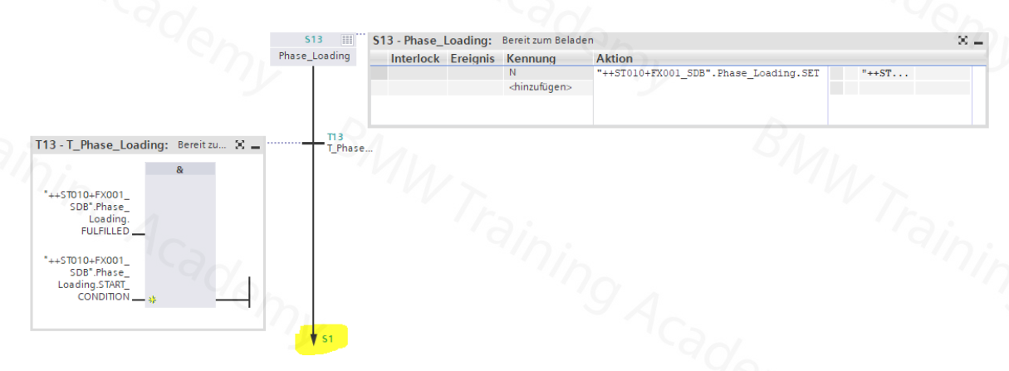
At the end of the sequencer, before jumping back to step 1, the initial phase must be activated:

Slide 9
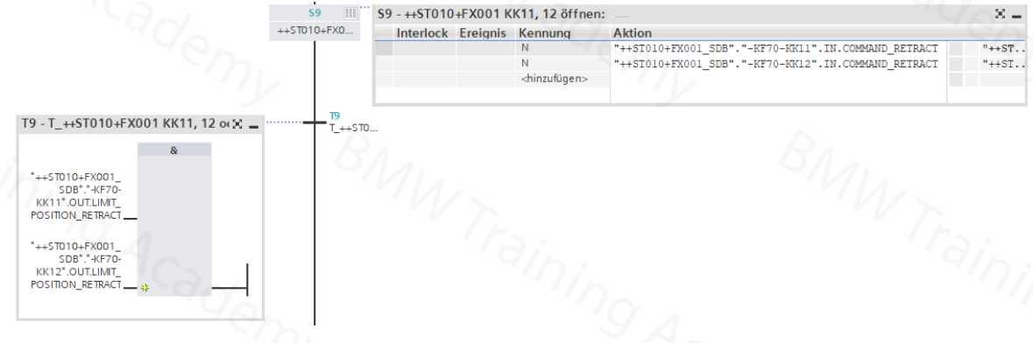
Both the actuator control in the step and the transition formation must be carried out exclusively with signals from the SEQ interface of the relevant actuator component :
The use of the actuator outputs and the relevant inputs such as e.g Clamp end positions is only permitted on the actuator module and not in the further sequence program!

Slide 11



Contact Us
LINK Group Headquarter
Shanghai, China
LINK Group North China
Shenyang, China
LINK Group Europe (LKGG GmbH)
Bad Reichenhall, Germany
Enquiry
Enquiry
Enquiry
ying.liu@LKautomation.com
kimi.wang@LKautomation.com
jackey.yin@LKautomation.com
+86 021 6918 0161
+86 021 6918 0161
+86 186 2171 9367
Sales
Sales
Sales
gene.zhang@LKautomation.com
gene.zhang@LKautomation.com
andreas.reymendt@LKautomation.com
+86 136 2179 1621
+86 136 2179 1621
Address
BLDG #D,North Jiasong Road No.3570 Jiading District,Shanghai,P.R.China
Address
NO. 14 22nd Floor,NO.168-3 Harbin Road,
Shenhe District,Shenyang,Liaoning
Province,P.R.China
Address
Fischerbraeuwiese 18b,83435 Bad
Reichenhall,Bavaria,Germany

